Slide 1


FINANCE INTRO
2025

Slide 2

2
01 MEETING THE FINANCE TEAM
02 CONTACTS
03 MACONOMY / FINANCE PLUS
04 PAYOLL / PAYSLIPS
05 POLICIES

Slide 3
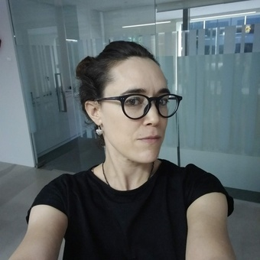



FINANCE TEAM – WHO DOES WHAT?
Jo Furney (Financial and Ops Director) - Financial and Compliance Oversight / Legal / Scope and rate queries.
Natasha Wharmby (Senior Financial Controller) – Oversees Finance / Payroll liaison / Oversees revenue.
Harvey O’Hara (Management Accountant)– Patek Finance Management / Manage month end.
Abi Brown (Senior Finance Assistant) – Maconomy Help / Accounts Receivable and Accounts Payable / VAT / Revenue / Barclaycard holder.

Slide 4

4
4
Contacts
Send expenses to:-
expenses.emea@groupsjr.com
General finance queries:-
finance.emea@groupsjr.com
Payroll contact:-
payrollservices@wpp.com
4

Slide 5

5
5
PAYROLL
Payday falls on the 25th of the month (if this happens to be over the weekend you will be paid on the Friday before the weekend)
Payslips and P60’s are viewable on SD Worx
Look out for an email from SD Worx to register on OKTA
Our payroll is managed by WPP Payroll Services
Any queries with SD Worx portal issues please email payrollservices@wpp.com
5

Slide 6




SJR FINANCE TOOLS & SUPPORT
MACONOMY – Web-based financial management system
Why do you need to use it?
Expenses
Purchase Orders
Timesheets
Submitting new vendors (role dependent)
(Abi to give training on Maconomy)
GLOBAL
Who are they and what do they do?
Payments (Invoices / Expenses)
Credit Control
Processing invoices
LONDON
US
TORONTO

Slide 7

Travel & Expenses
Concur is the WPP travel booking tool – Jamila & Mina can help book
Expenses should be submitted timely (3 months deadline)
Please refer to the “Travel & Expenses” policy.
Gifts & Entertainment
Apply the common sense and consider what others would think. Would your acceptance of a gift or hospitality be perceived by the average member of the public as unusual or excessive?
Gifts over £150 must be pre-approved by Selena (CEO) or Tom (MD) AND Jo (FD)
Please refer to the “Gifts & Entertainment” policy
Bribery
Paying or receiving bribes by any person is completely prohibited. Facilitation payments are also completely prohibited. There are no exceptions.
Please refer to the “How We Behave & Belonging at WPP” mandatory training.
POLICIES &
PROCEDURES
Notes:
Gabrielle / Nayantara

Slide 8
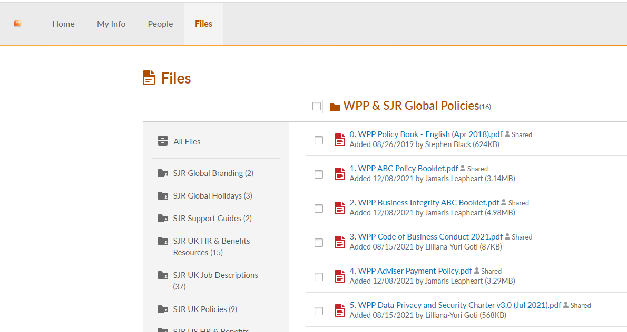
All relevant policies can be found on Bamboo under the “Files” section
POLICIES &
PROCEDURES
https://groupsjr.bamboohr.com
Notes:
Gabrielle / Nayantara

Slide 9

THANK YOU

